Slide 1

SCMS School of Engineering & Technology
Department of Computer Science and Engineering
SCMS E-PASS
GUIDE
PROJECT COORDINATOR
GROUP MEMBERS
Gourisankar Anilkumar(SCM22CS110)
Hadhi Muhammed (SCM22CS113)
Hiba Thanseem(SCM22CS117)
Malavika Ravi(SCM22CS139)
Dr.Dhanya K A,
Ms. Rosebell Paul
Asst. Professor,
Dept. of CSE
Asst. Professor,
Dept. of CSE

Slide 2
01
Introduction
02
Objectives
03
Problem Statement
CONTENS
04
Software and Hardware requirements
05
Proposed Methodology
06
Database
07
Screenshots or Results
08
Application, Merits
09
Conclusion
10
References

Slide 3

01. Introduction
User-friendly online platform for hostel students to obtain weekend bus passes.
Eliminates the need for physical visits to the office by enabling digital booking and payment.
Features include UPI payment integration, GPS tracking, and real-time seat availability for efficient management.
Ensures seamless and secure e-pass generation, which can be accessed on mobile devices..
The project involves web and mobile development, incorporating technologies like React.js, Node.js, MongoDB, and payment gateway integration.

Slide 4
02. Objectives
01
Simplify Bus Pass Booking
Develop an intuitive system that allows students to book and pay for their weekend bus passes online, eliminating manual procedures.
02
Enhance Transparency
Provide students with real-time seat availability, bus schedules, and tracking options to ensure clarity and efficiency.
03
Optimize Seat Allocation
Implement a first-come, first-served model for allocating extra seats to hostel students, ensuring fair distribution.

Slide 5
02. Objectives
04
Improve User Experience
Create an easy-to-use interface with secure authentication, digital pass storage, and GPS tracking for enhanced convenience.
05
Ensure Scalability & Performance
Design a robust system capable of handling multiple bookings, real-time seat updates, and secure payment transactions without performance issues.

Slide 6
03. Problem Statement
The current process of obtaining a weekend bus pass requires hostel students to physically visit the office, leading to inconvenience and time wastage.
Manual processes often result in delays, inefficiencies, and errors in managing bus pass requests and payments.
The absence of a real-time tracking system makes it difficult for students to know seat availability and bus schedules.

Slide 7
03. Problem Statement
There is no centralized digital system to manage bookings, payments, and bus tracking, making it challenging to ensure transparency and efficiency.
A digital E-Pass system will streamline this process by providing online booking, digital payments, seat allocation, and GPS tracking.

Slide 8
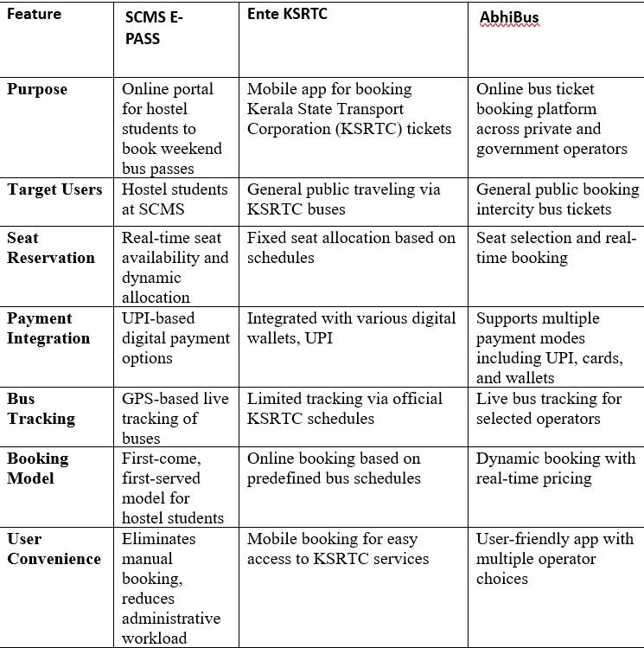
03. Literature Survey

Slide 9
04. Software Requirements
Front-end Libraries and Frameworks
Operating System
React.js, HTML, CSS, JavaScript for the user interface.
Any modern operating system such as Windows, MacOS, or Linux
Back-end Framework
Web Browser
Django.js for handling requests, payments, and seat allocations.
Modern Web Browsers such as Firefox, Chrome etc.
Code editor
Visual Studio Code
Database Management System
MongoDB for storing user data, bookings, and transactions.
Payment Gateway
UPI Integration for seamless online transactions.

Slide 10





04. Hardware Requirements
A minimum of 4GB RAM and a dual-core processor to handle user requests efficiently.
Stable internet connection to support online bookings and real-time GPS tracking.
Accessible on desktops, laptops, tablets, and smartphones via a web or mobile application.

Slide 11
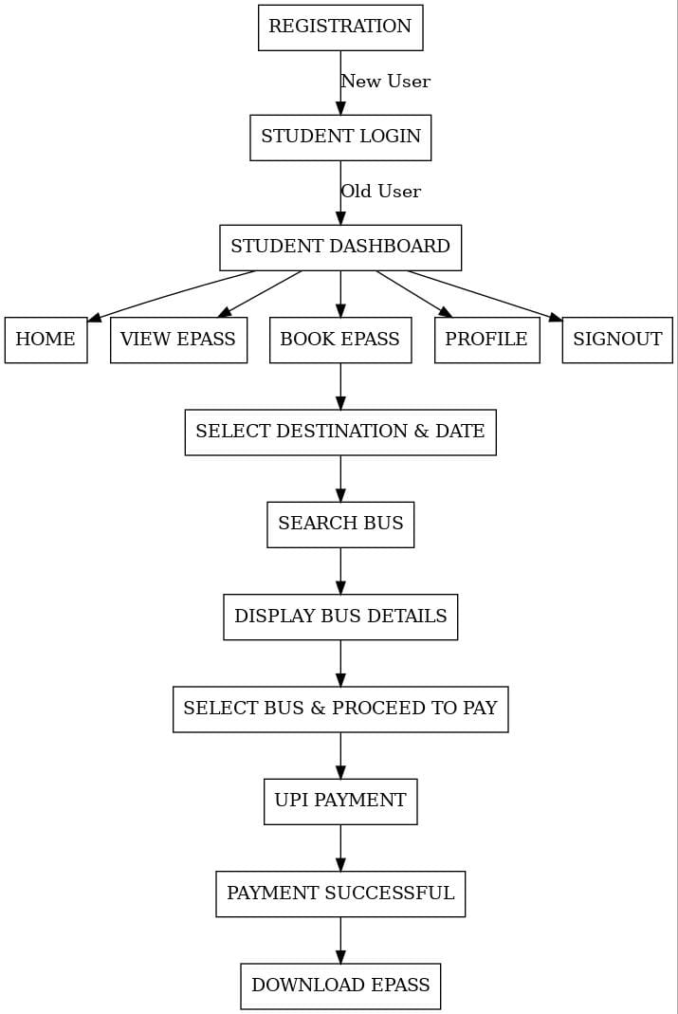
05. Proposed Methodology
Fig1. Flow Chart

Slide 12
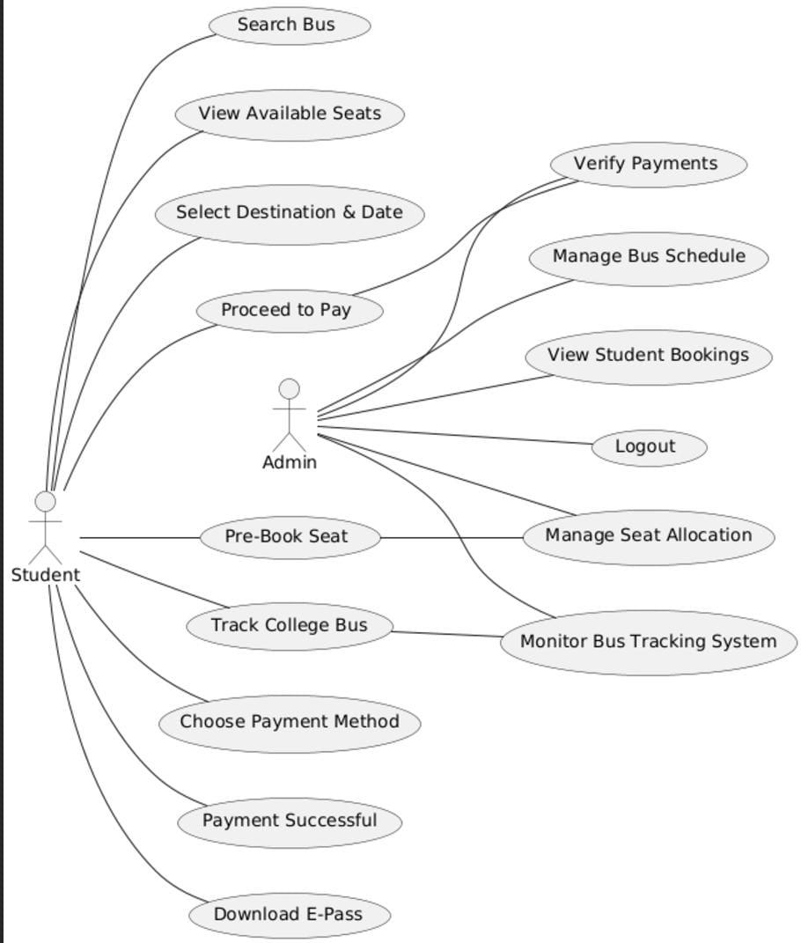
Fig2. Use Case

Slide 13
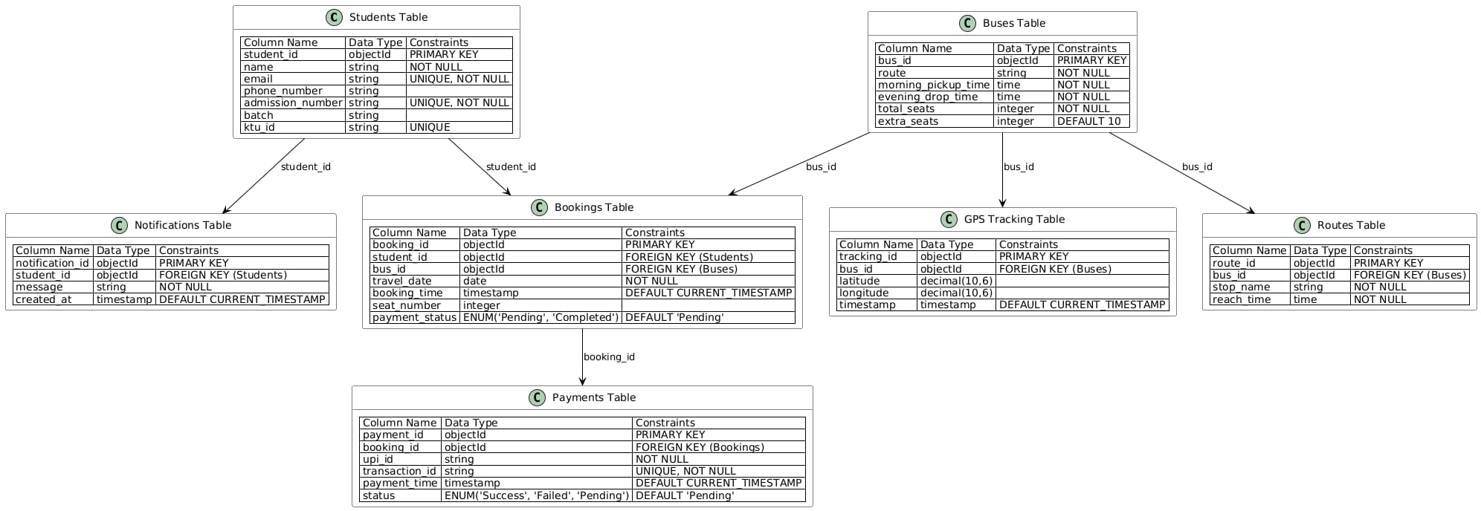
06. Database
Fig3. Database Collection

Slide 14
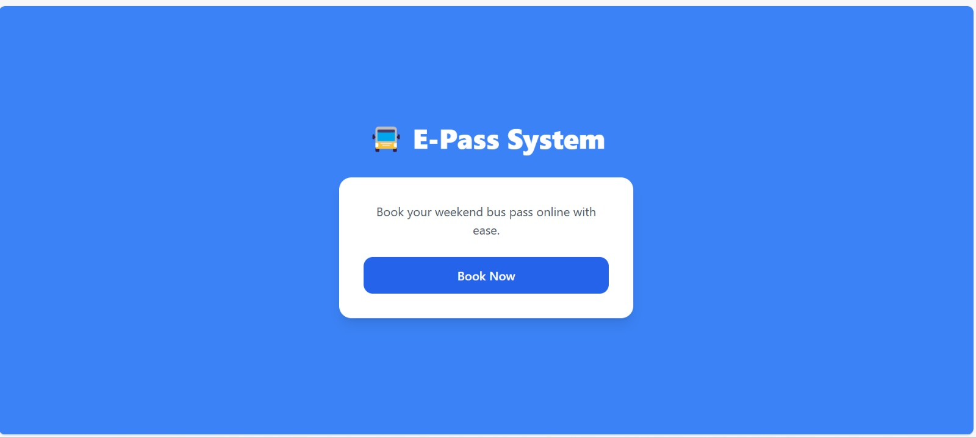
07. Screenshots or Results

Slide 15
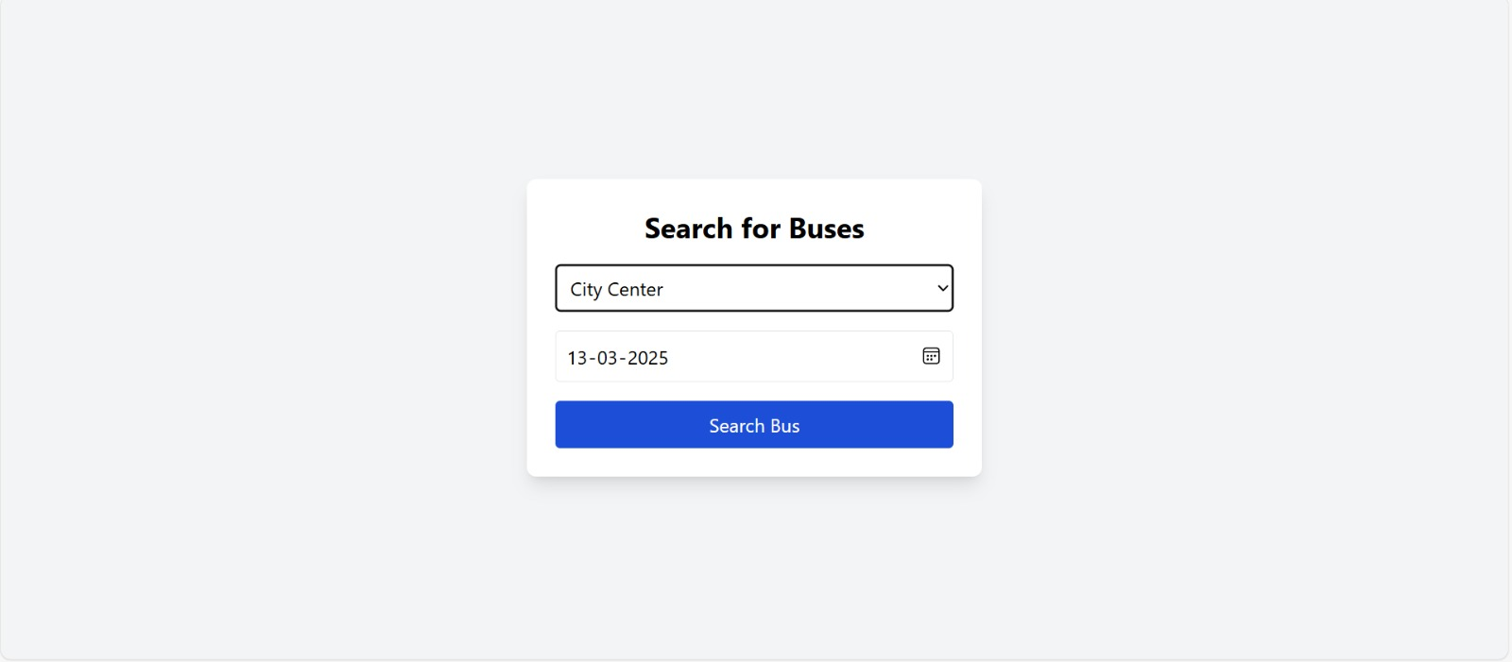
07. Screenshots or Results

Slide 16
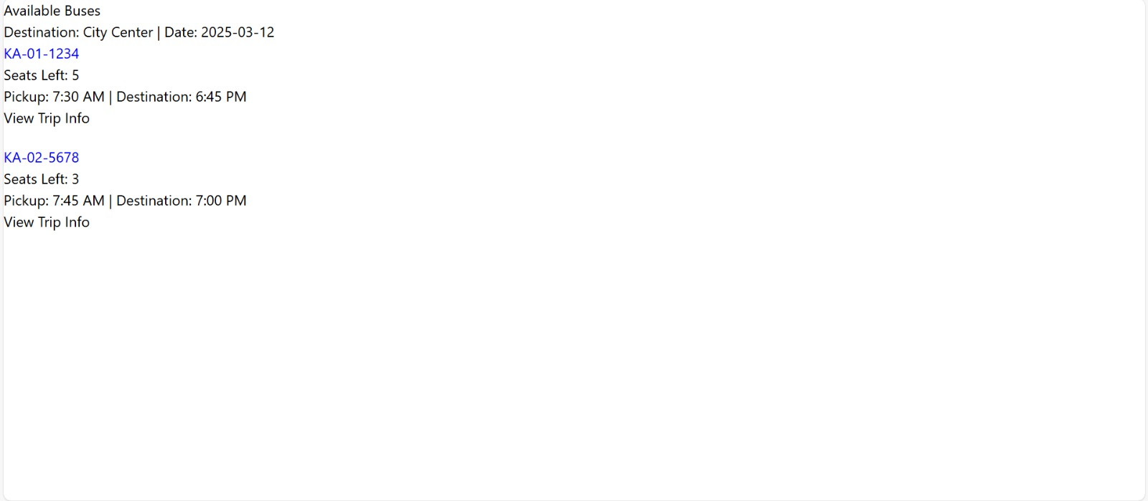
07. Screenshots or Results

Slide 17
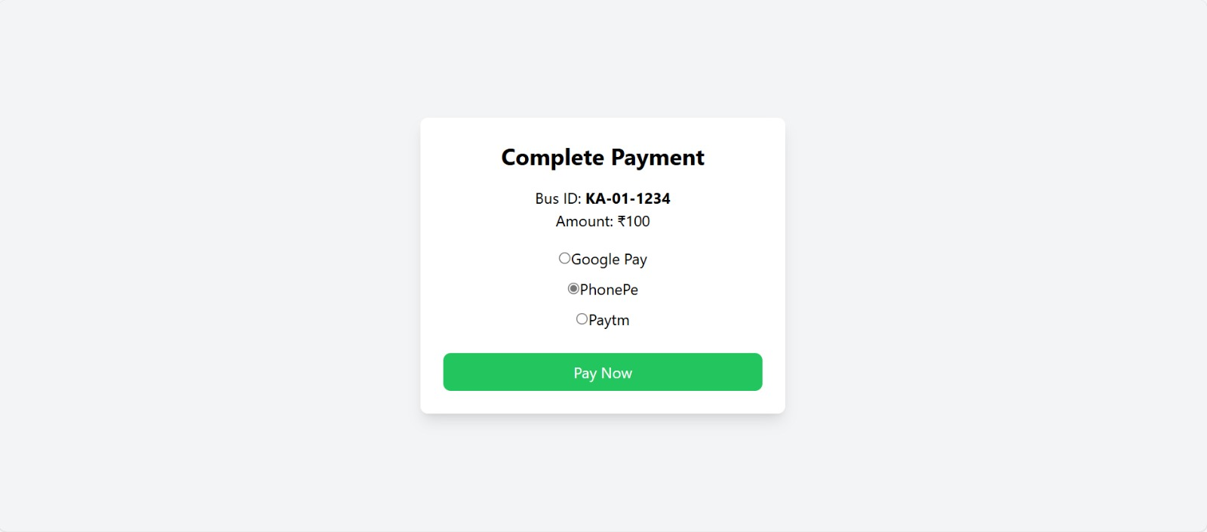
07. Screenshots or Results

Slide 18
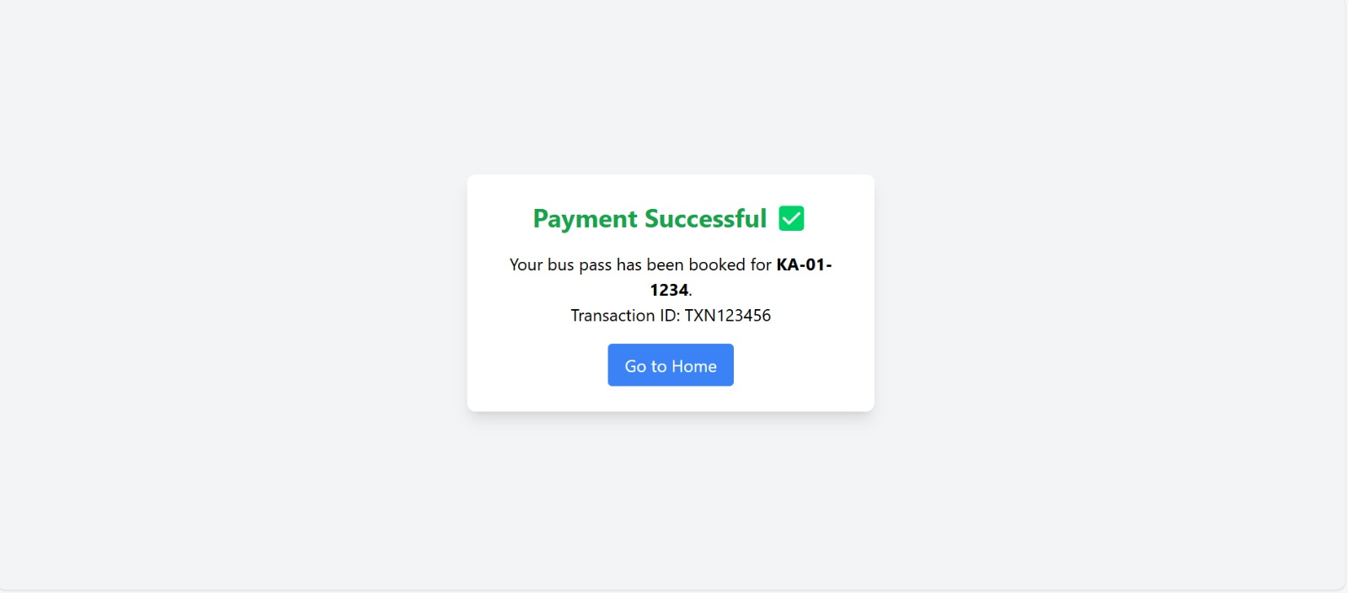
07. Screenshots or Results

Slide 19
08. Applications and Merits
Seamless Bus Pass Management
25%
The system enables students to apply for a weekend bus pass online, eliminating the need for manual paperwork and office visits.
Real-time Seat Availability
25%
Students can check seat availability in real time and book accordingly, ensuring they secure a spot without hassle.
Digital Payments for Convenience
Integrated UPI payment options allow students to pay for their bus pass instantly and securely.
Enhanced Transparency and Efficiency
A centralized platform maintains records of applications, approvals, and payments, ensuring accountability and eliminating fraudulent claims.

Slide 20
08. Applications and Merits
GPS-based Bus Tracking.
The system provides real-time bus tracking, enabling students to monitor bus routes, arrival times, and delays for better planning.
Scalability and Future Expansion.
The system is designed to accommodate an increasing number of students and additional features, such as special passes for events or academic trips

Slide 21
09. Conclusion
By leveraging modern web technologies such as React.js, Next.js, Node.js, and MongoDB, we have developed an efficient and user-friendly E-Pass system for hostel students.
This digital solution eliminates the inefficiencies of the traditional manual process, allowing students to apply, pay, and track bus passes seamlessly.
With real-time seat availability, online payments, our system ensures transparency, convenience, and improved transportation management for students.We aim to provide a scalable and reliable platform that enhances student mobility while reducing administrative workload, ensuring a smooth and stress-free weekend travel experience.

Slide 22
10. References
https://www.codewithrandom.com
https://www.academia.edu
https://github.com
https://www.w3schools.com
https://www.codecademy.com/
https://www.freecodecamp.org/
https://www.coursera.org/
https://www.edx.org/
https://stackoverflow.com/
https://developer.mozilla.org/

Slide 23
THANK YOU

